Slide 1

Movie Sales Visualizations -Visualizing Insights from Movie Sales Data
-Jahnavi Lolla
CMIS ID- AF0417260
Batch Code- ANP-C8713

Slide 2
Contents:
Project Objective
Import and prepare data
Data Import
Importing Data from Excel workbook
Visualizations
Waterfall Chart
Line Chart
Gauge
Funnel
Clustered Column Chart
Area Chart
Pie Chart
Line and Stacked Column Chart

Slide 3
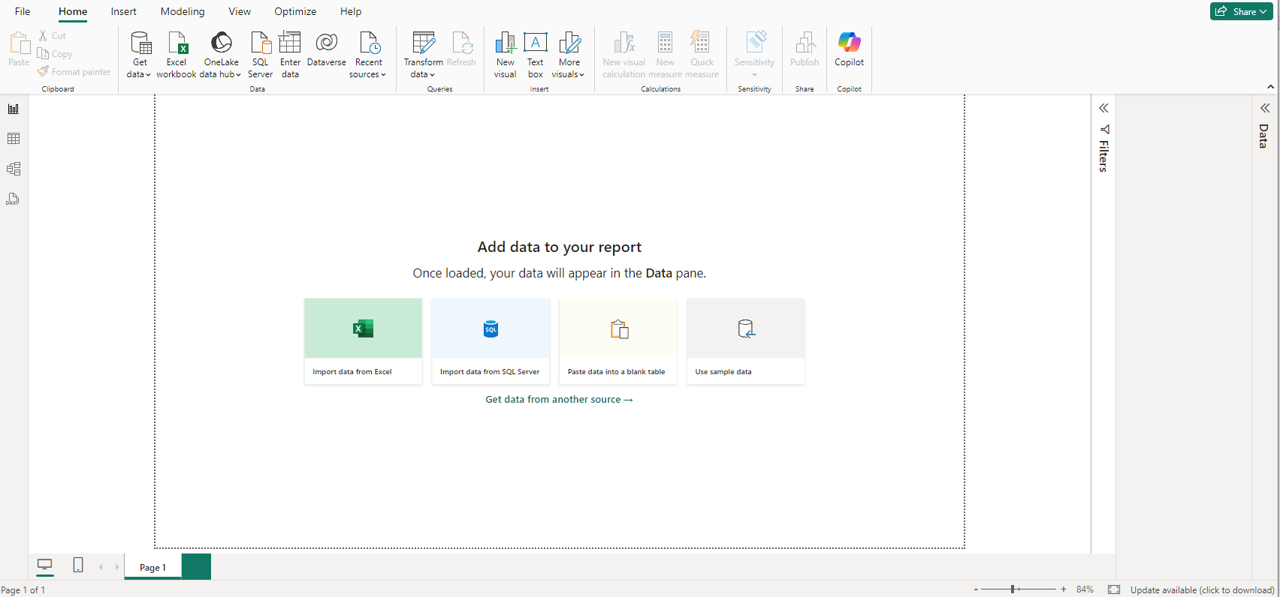
Project Objective: To analyze and visualize movie sales data to gain insights into trends, performance, and factors influencing revenue. My data says about the movie, director, running time of the movie, actors, genre, budget, box office, actors box office, directors box office, earnings, Oscar and Golden Globes nominations, Oscar and Golden Globes awards, release year, and IMDB score of the movies. We should import our excel data into Power BI to add visualizations and to prepare a dashboard. Import and Prepare Data: Data Import: Use Power BI’s Get Data feature to connect to data sources.

Slide 4
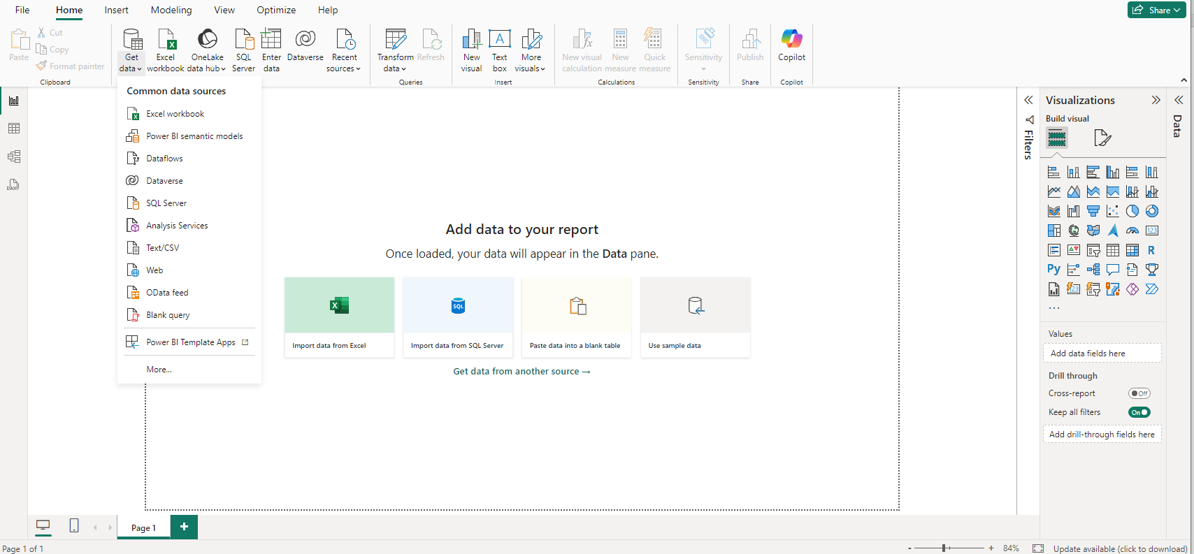
Get data from Excel workbook.

Slide 5

VISUALIZATIONS: 1) Waterfall chart 2) Line Chart 3) Gauge 4) Funnel 5) Clustered Column chart 6) Area chart 7) Pie chart 8) Line and Stacked Column chart

Slide 6
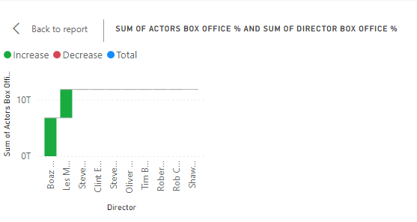
1) WATERFALL CHART: This waterfall chart in the below picture represents the data of total sum of actors box office percentage and the total sum of directors box office percentage. X- Axis: Sum of directors box office percentage Y- Axis: Sum of actors box office percentage

Slide 7
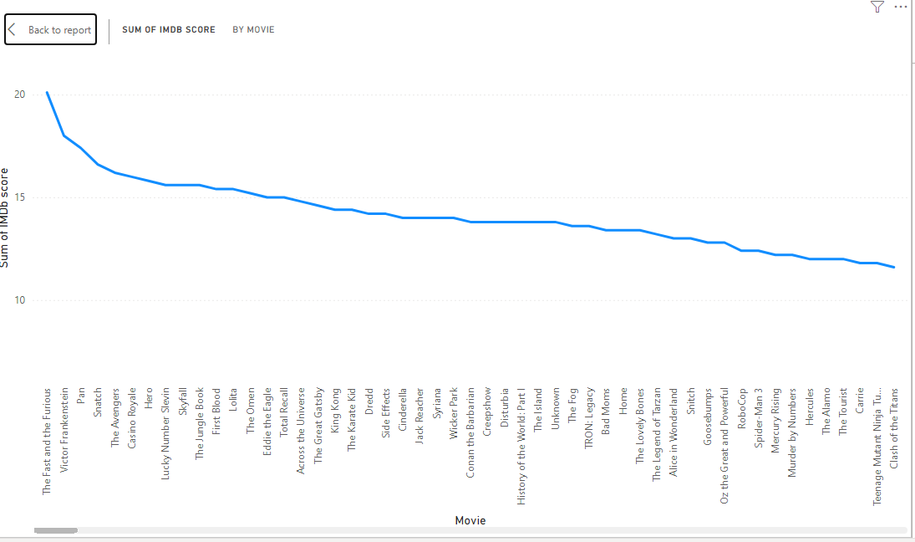
2) LINE CHART: The line chart in the below picture represents the data of movie and the IMDB score of the movies. X- AXIS: Movies Y- AXIS: IMDB Score

Slide 8
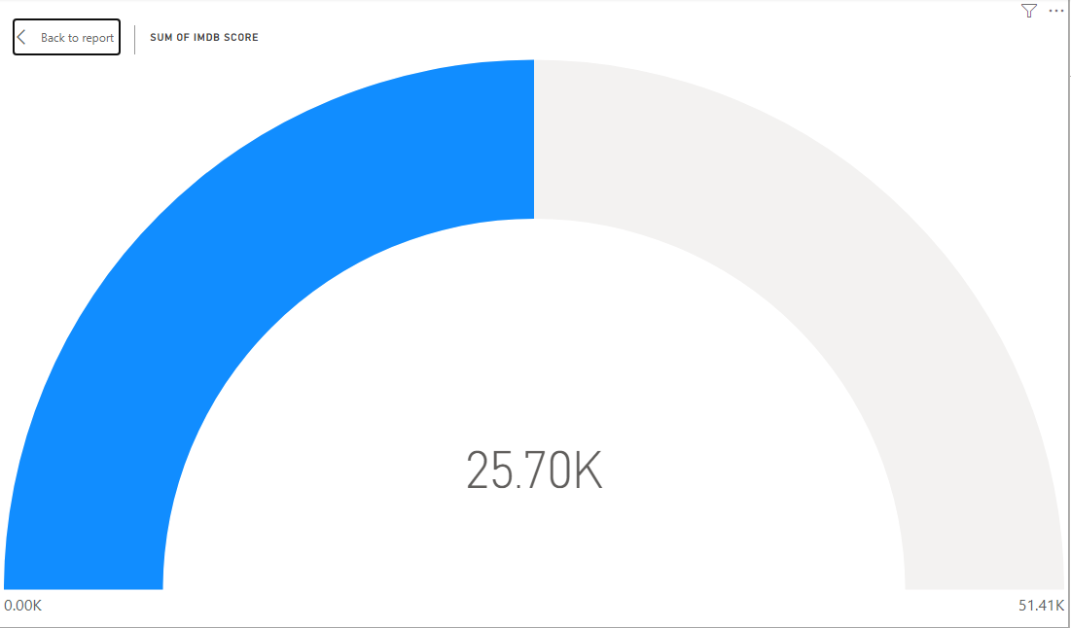
3) GAUGE: The Gauge in the below picture represents data the total sum of IMDB score of the movies.

Slide 9

4) FUNNEL: The funnel in the below picture represents the data of total sum of budget by actor 1.

Slide 10
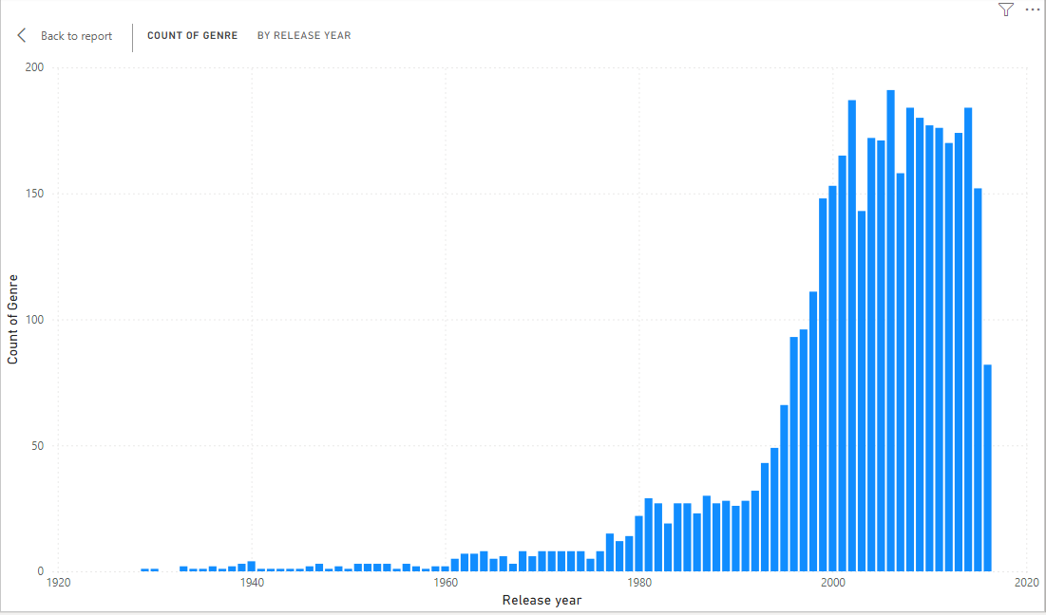
5) CLUSTERED COLUMN CHART: The below clustered column chart represents data of the genre and the total count of the genre and the release years of movies. X- AXIS: Release year Y- AXIS: Count of Genre

Slide 11
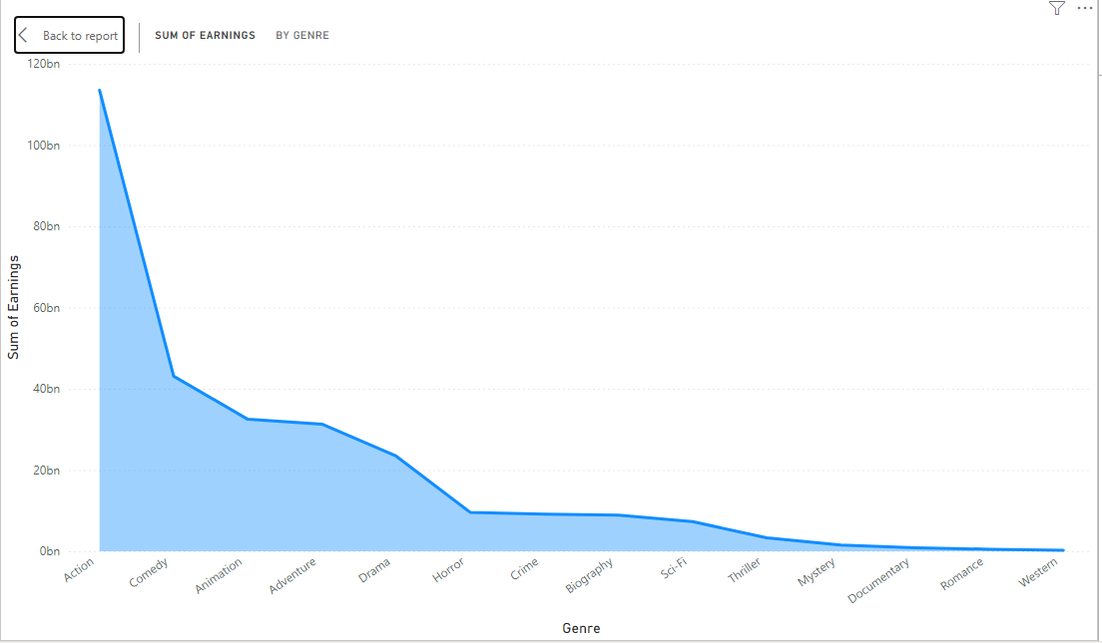
6) AREA CHART: The below area chart represents the data of genre and the total sum of earnings. X- AXIS: Genre Y- AXIS: Sum of earnings

Slide 12
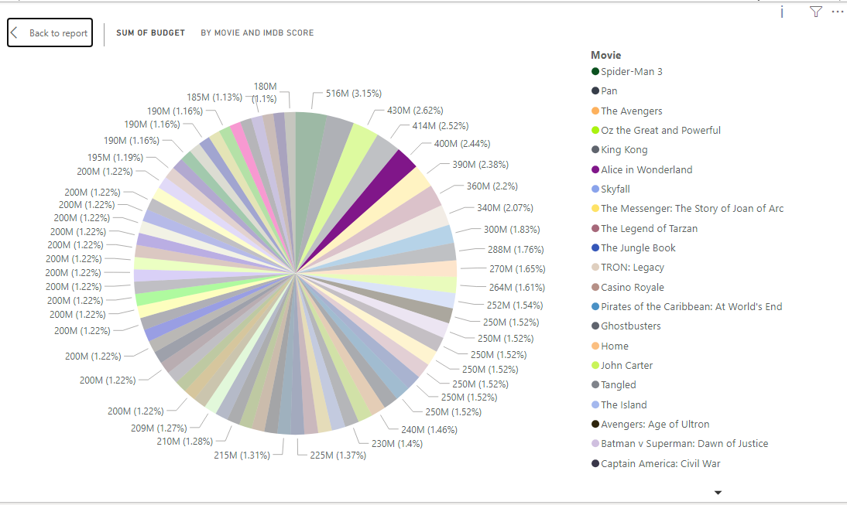
7) PIE CHART: The below pie chart represents the data of the sum of budget by movie and IMDB score.

Slide 13
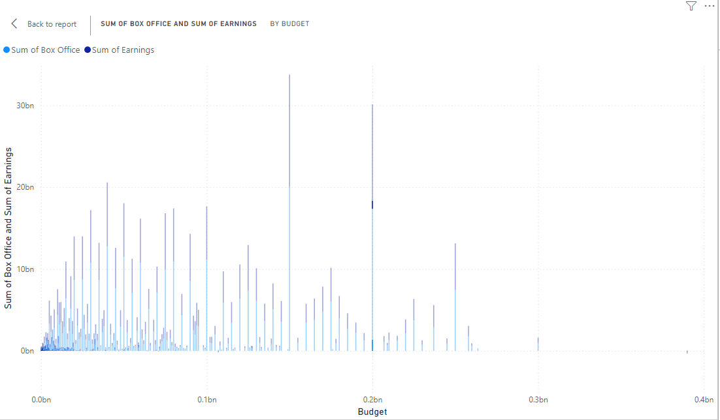
8) LINE AND STACKED COLUMN CHART: The below line and stacked column chart represents the data of the budget and the sum of box office and the total sum of earnings. X- AXIS: Budget Y- AXIS: Sum of box office and sum of earnings.

Slide 14
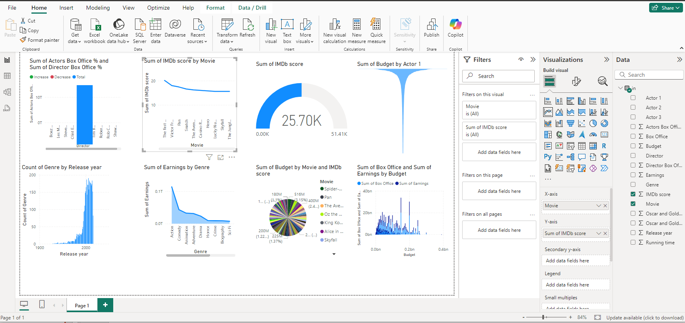
DASHBOARD:

Slide 15


